Slide 1
Project : Modern Approaches to the Knapsack and TSP Bottlenecks
(Evaluating Performance Trade-offs in Branch & Bound for TSP and 0/1 Knapsack)
Name: Prottoy Paul
Roll: 1613
Course: SE 2105
Supervisor: Shah Mostafa Khaled , PhD
Institute of Information Technology,DU

Slide 2
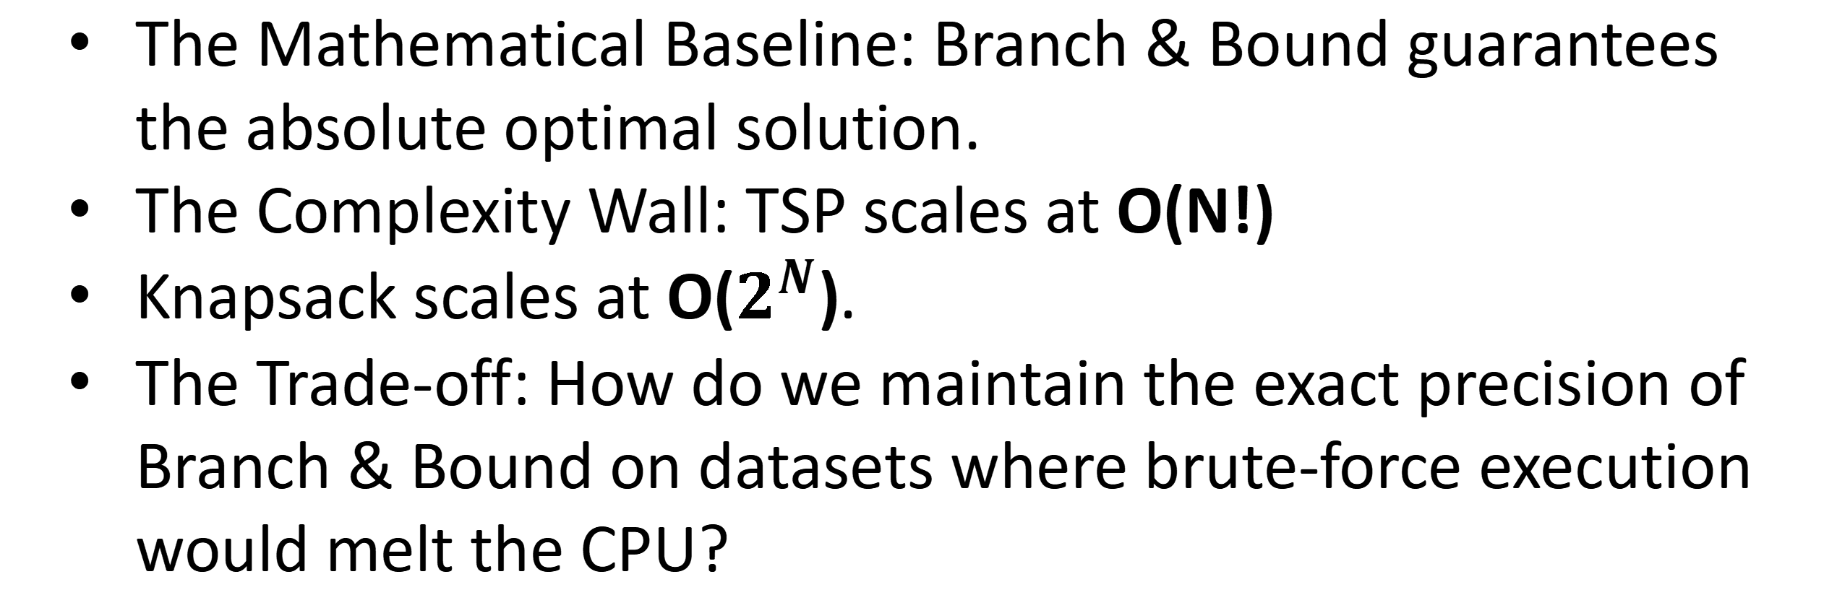
The Dual Mandate (Accuracy vs. Speed)
The Mathematical Baseline: Branch & Bound guarantees the absolute optimal solution.
The Complexity Wall: TSP scales at O(N!)
Knapsack scales at O($2^{N}$).
The Trade-off: How do we maintain the exact precision of Branch & Bound on datasets where brute-force execution would melt the CPU?

Slide 3
The Exact Engine (Branch & Bound Implementation)
TSP B&B : Uses Matrix Reduction (subtracting row/column minimums) to calculate a strict Lower Bound for route pruning.
Knapsack B&B (knapsack.c): Uses value/weight ratios to calculate maximum potential profit bounds for capacity pruning.
Memory Management: Both utilize custom state-space tracking (e.g., a 2,000,000 node Min-Heap for TSP) to prioritize the most promising paths.

Slide 4
Identifying the Hardware Limits
TSP Breaking Point: N = 22 Beyond 22 cities, the 2-million node Min-Heap overflows, crashing the system's RAM.
Knapsack Breaking Point: N = 28 Beyond 28 items, the deep recursive tracking triggers stack limitations and exponential time delays.
The Pivot: To satisfy performance metrics, the architecture must actively prevent users from triggering these crashes.

Slide 5
Scaling TSP
(Phase 1: Warm-Starting B&B)
The Defect: Standard B&B explores the tree blindly with an upper bound of INFINITY.
The Fix: Run a lightning-fast Ant Colony (ACO) heuristic for 5 milliseconds first.
The Trade-off: Spend a tiny amount of time upfront to generate a strict, realistic Upper Bound. B&B immediately prunes 90% of the tree.

Slide 6
Scaling TSP
(Phase 2: Clustered Micro-Routing)
The Strategy: Divide and Conquer via K-Medoids.
Execution: Break a 100-city map into localized zones of 10-12 cities. Run the exact, warm-started B&B independently inside each zone.
Result: Guaranteed local mathematical perfection executed in milliseconds.

Slide 7
Scaling Knapsack
(Phase 1: The Greedy Baseline)
The Metric: Value Density (Profit per Unit of Weight).
The Trade-off: Standard Greedy sorting is blazing fast
(O(N log N)) but mathematically imperfect because it leaves empty gaps in the knapsack.

Slide 8
Scaling Knapsack
(Phase 2: The Core-Problem Hybrid)
The Strategy: Dantzig-Wolfe Decomposition.
Execution:
Sort all items by density and find the "Break Item" where capacity fails.
Lock the obvious high-density items. Discard the obvious low-density junk.
Slice a "Core" of 40 ambiguous items around the break point.
Feed only the Core into the Exact B&B solver.

Slide 9
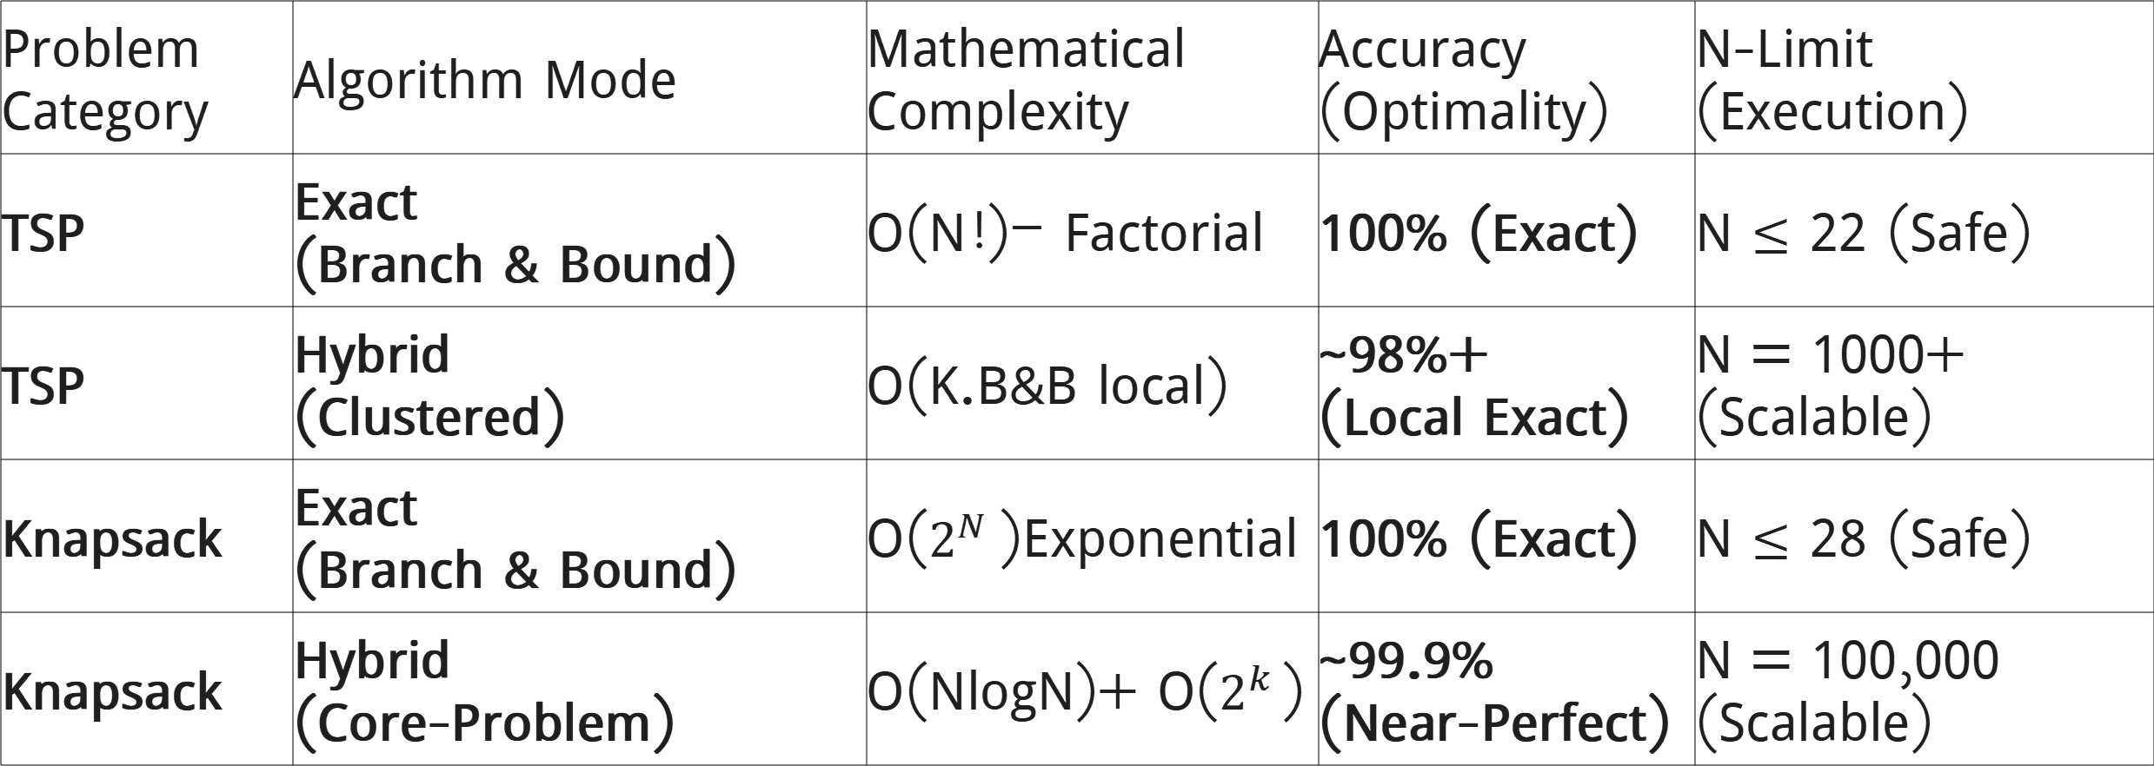
Performance, Complexity & Accuracy Comparison
Theoretical Complexity
Problem Category | Algorithm Mode | Mathematical Complexity | Accuracy (Optimality) | N-Limit (Execution)
TSP | Exact (Branch & Bound) | O(N!)— Factorial | 100% (Exact) | N $≤$ 22 (Safe)
TSP | Hybrid (Clustered) | O(K.B&B local) | ~98%+ (Local Exact) | N = 1000+ (Scalable)
Knapsack | Exact (Branch & Bound) | O($2^{N}$)Exponential | 100% (Exact) | N $≤$ 28 (Safe)
Knapsack | Hybrid (Core-Problem) | O(NlogN)+ O($2^{k}$) | ~99.9% (Near-Perfect) | N = 100,000 (Scalable)

Slide 10
User Interface & Safety Architecture
Frontend: Java Swing (TSPPanel.java, KnapsackPanel.java).
Dynamic Visualization: Java Graphics2D rendering for interactive matrix and graph validation.
The Interceptor: If a user requests Mode 1 (Pure B&B) on N=50, the UI safely intercepts and re-routes to the massive-scale Hybrids to prevent JVM/C-backend crashes.

Slide 11
Project Workflow & Execution Pipeline
The Full-Stack Optimization Loop:
User Input (Java Swing): User configures N and selects the algorithm mode.
The Safety Interceptor: The UI checks N against the "Complexity Wall" (N > 22 for TSP) and re-routes to Hybrid engines to protect system memory.
The Data Bridge: Java writes the problem state to input.txt and executes the C backend via a ProcessBuilder stream.
C-Backend Orchestration:
Parsing: The C engine loads the matrix/items into manual memory structures.
Optimization: The engine executes the Branch & Bound search tree, often warm-started by ACO or reduced by Clustering.
Result Streaming: The C engine writes the final path/profit and execution metrics to solution.csv.
Visual Rendering: Java parses the CSV, updates the results table, and draws the optimized route/knapsack bars using Graphics2D.

Slide 12
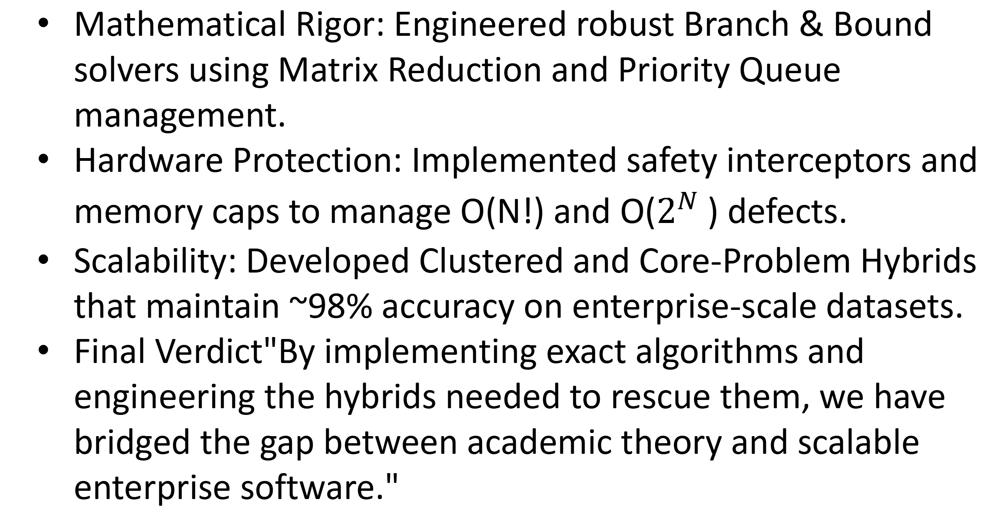
Conclusion & Acknowledgements
Mathematical Rigor: Engineered robust Branch & Bound solvers using Matrix Reduction and Priority Queue management.
Hardware Protection: Implemented safety interceptors and memory caps to manage O(N!) and O($2^{N}$) defects.
Scalability: Developed Clustered and Core-Problem Hybrids that maintain ~98% accuracy on enterprise-scale datasets.
Final Verdict"By implementing exact algorithms and engineering the hybrids needed to rescue them, we have bridged the gap between academic theory and scalable enterprise software."

Slide 13
THANK YOU..

